Slide 1
Bio334 Phylogenetic reconstruction Part I: Distance-based methods
Janko Tackmann & Nicolas Näpflin
For questions, feel free to contact us on Slack or via:
janko.tackmann@mls.uzh.ch or nicolas.naepflin@mls.uzh.ch

Slide 2
Setup for today
Exercises: Bio334/04_njtrees/exercises
If you haven’t cloned the repository yet:
Open the terminal, `cd` to a directory of your choice, then type `git clone https://github.com/meringlab/Bio334`
If you cloned it yesterday:
make sure to type `git pull` within the Bio334 folder to get the latest updates

Slide 3
Exercise 1 – Questions
Complexity

Slide 4
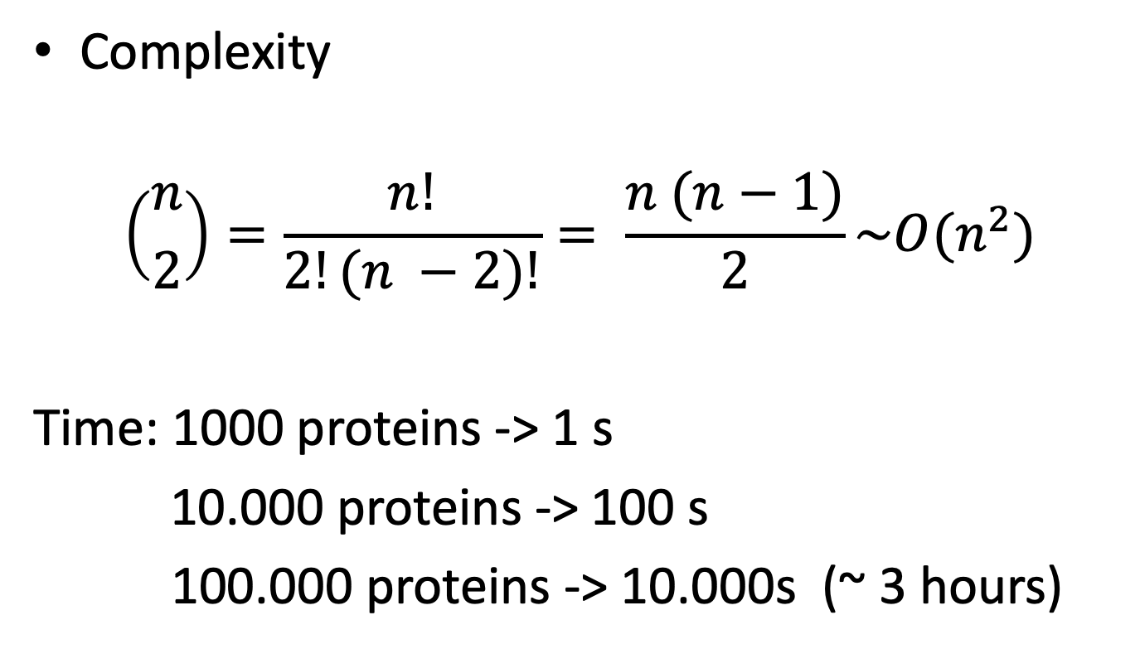
Exercise 1 – Questions
Complexity
$$\left({n \atop 2}\right)=\frac{n!}{2!(n −2)!}= \frac{n (n−1)}{2}\sim O(n^{2})$$
Time: 1000 proteins -> 1 s
10.000 proteins -> 100 s
100.000 proteins -> 10.000s (~ 3 hours)

Slide 5
Exercise 1 – Questions
Shortcomings of naïve Jaccard

Slide 6
Exercise 1 – Questions
Shortcomings of naïve Jaccard
All amino acid transitions have equal probability: unrealistic
Use explicit substitution matrices (BLOSUM, PAM)

Slide 8
Exercise 1 – Questions
Shortcomings of naïve Jaccard
All amino acid transitions have equal probability: unrealistic
Use explicit substitution matrices (BLOSUM, PAM)
Dependencies between neighboring sites (e.g. indels) are not considered
Smaller gap penalties, explicit modeling

Slide 9
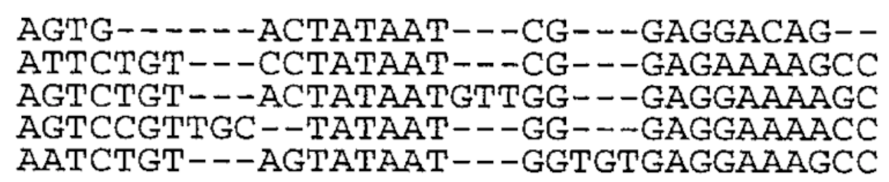

Slide 10
Exercise 1 – Questions
Nucleotides vs Amino acids

Slide 11
Exercise 1 – Questions
Nucleotides vs Amino acids
Nucleotides
High resolution: small differences can be detected
More neutrally evolving regions: less biased similarity estimates
Distinction between synonymous and non-synonymous mutations

Slide 12
Exercise 1 – Questions
Nucleotides vs Amino acids
Nucleotides
High resolution: small differences can be detected
More neutrally evolving regions: less biased similarity estimates
Distinction between synonymous and non-synonymous mutations
Amino acids
Stable over longer evolutionary time frames, used to address questions on non-recent evolution

Slide 13
Exercise 2 – Questions

Slide 14
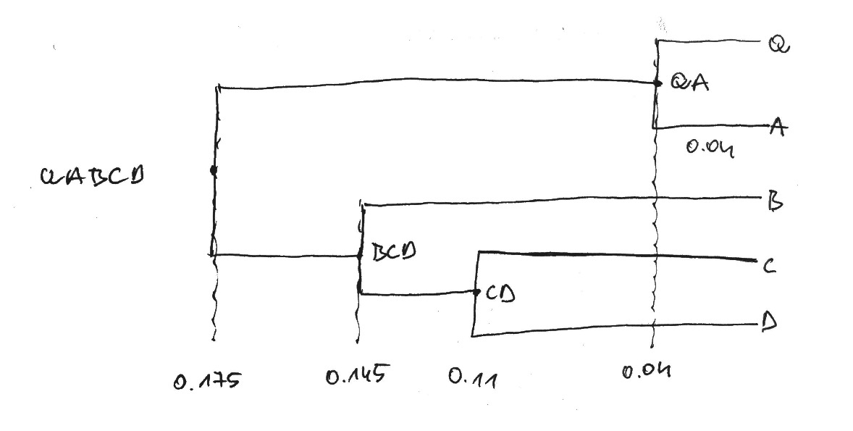

Slide 15
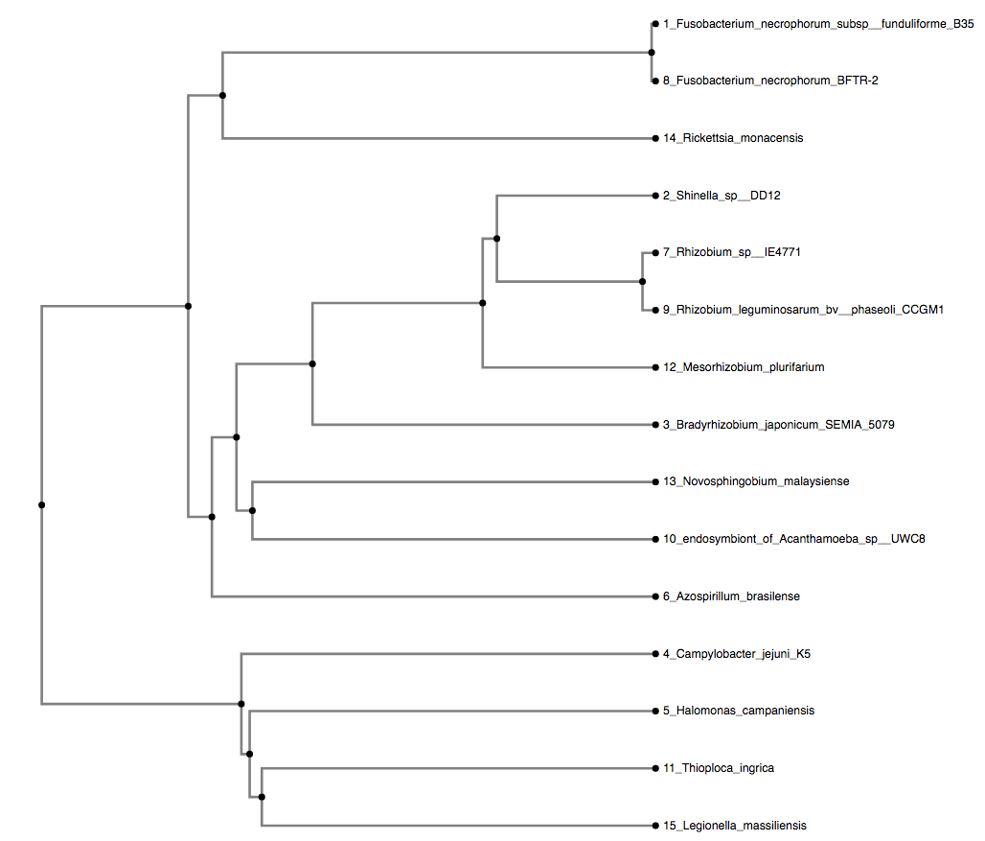
Exercise 3 – Questions

Slide 18
Fusobacterium necrophorum subsp. funduliforme B35

Slide 19
Fusobacterium
necrophorum
subsp. funduliforme
B35
Genus
Species
Subspecies
Type strain

Slide 20
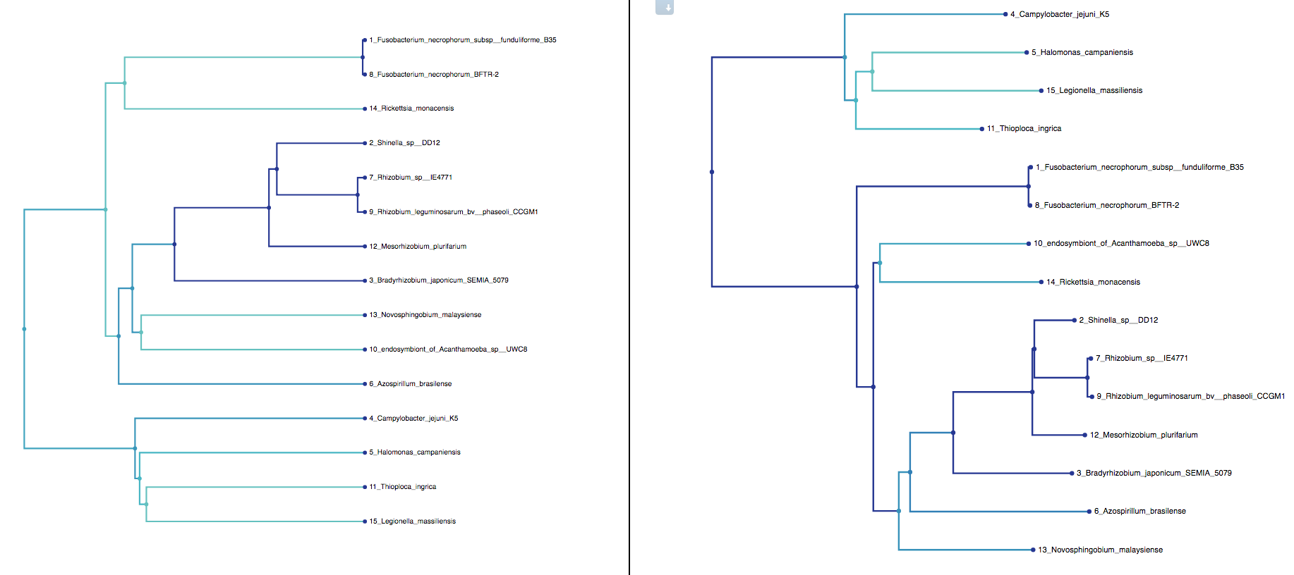
Exercise 4 – Questions

Slide 23
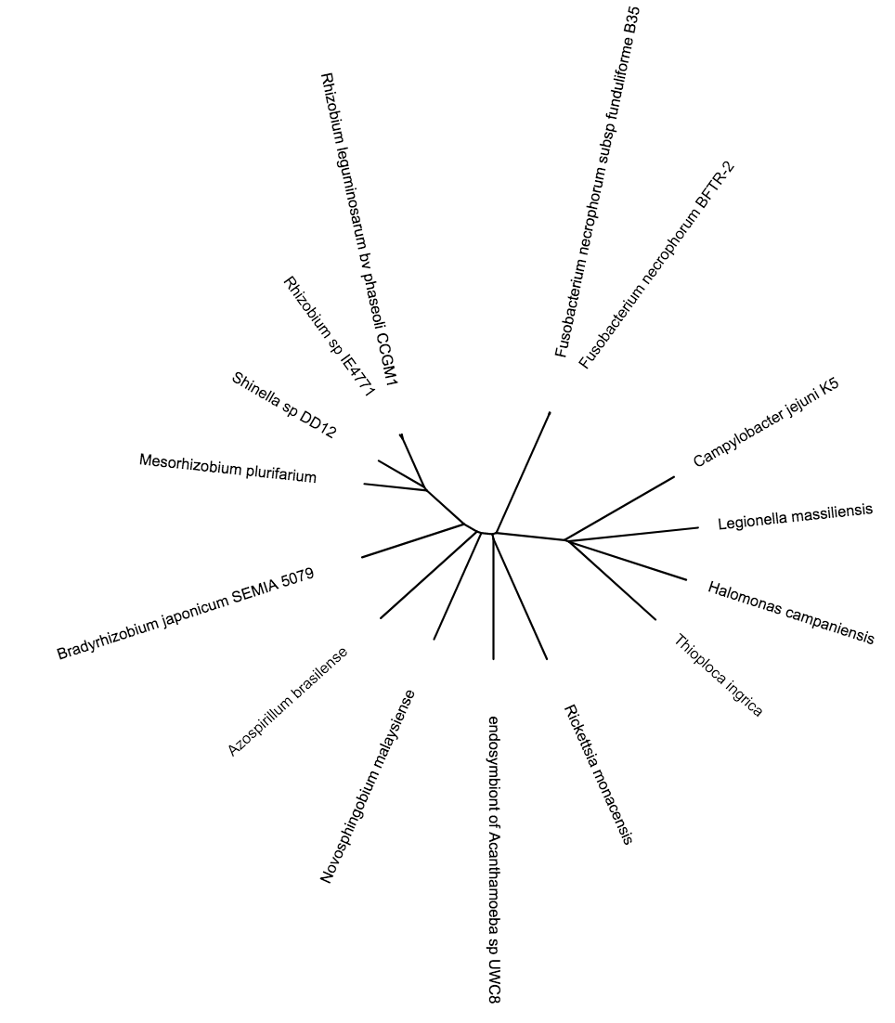

Slide 24
